Slide 1

Programming Introduction & Database 15/1/2023 UTM

Slide 2



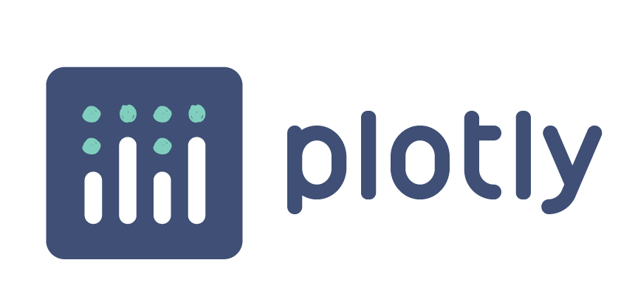



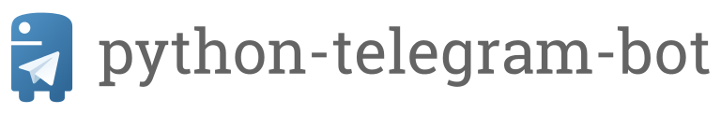
Nurul Farahain Mohammad
WORK
Data Scientist STMicroelectronics Sdn. Bhd.
QUALIFICATION
Ph.D. (Mathematics), UTM
B.Sc. (Mathematics), UTM
- AI-102 & AI-900: Microsoft Azure AI
- Fusionex Data Science Analyst
- Fusionex Data Engineering
CERTIFICATION
FAMILIAR PYTHON LIBRARIES

Slide 3
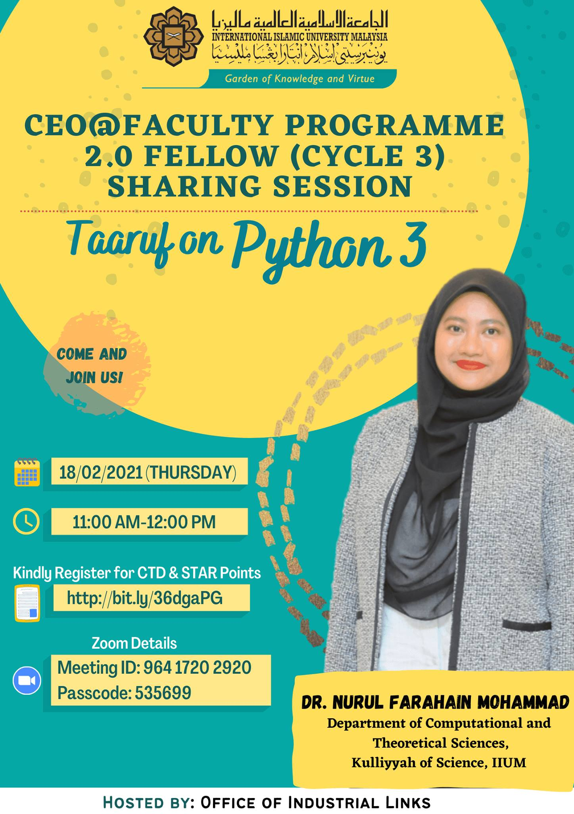
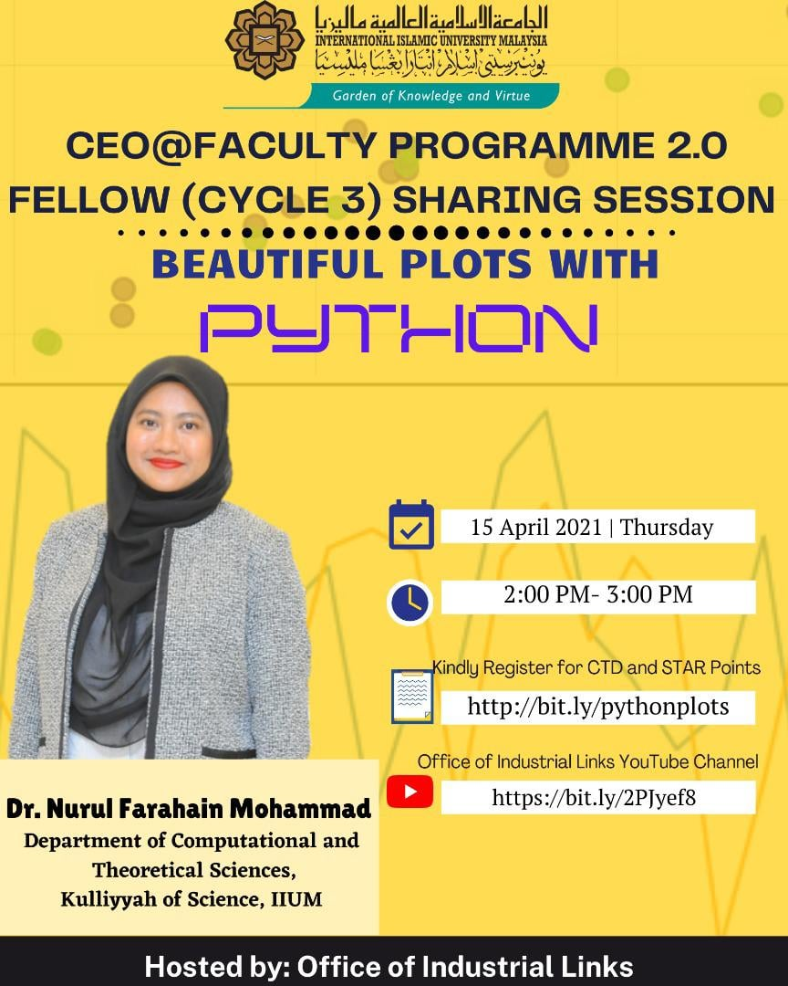
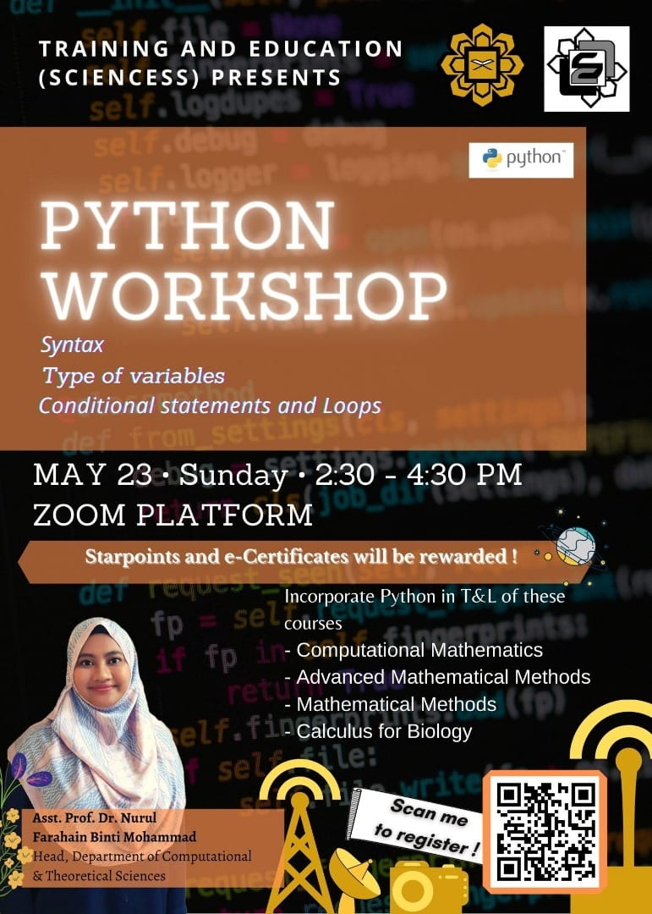
Python Workshops

Slide 4
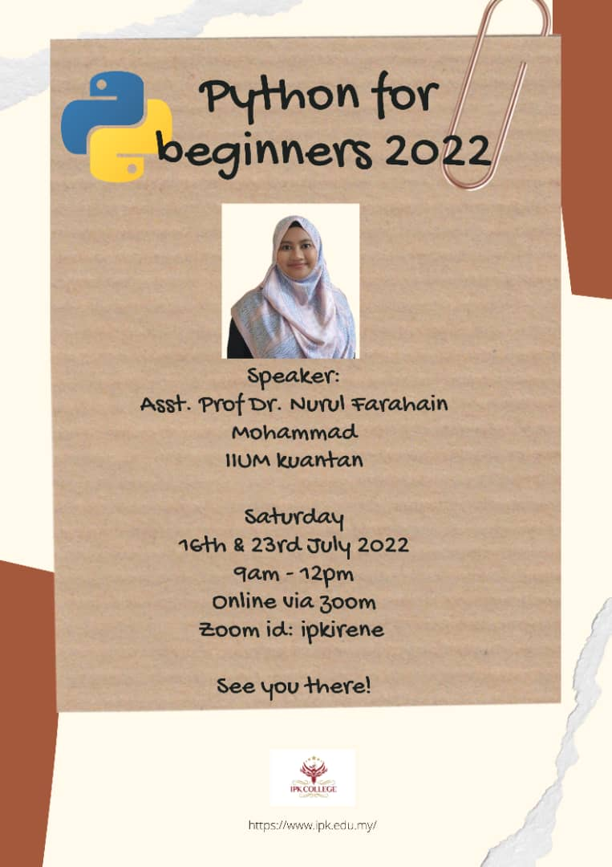
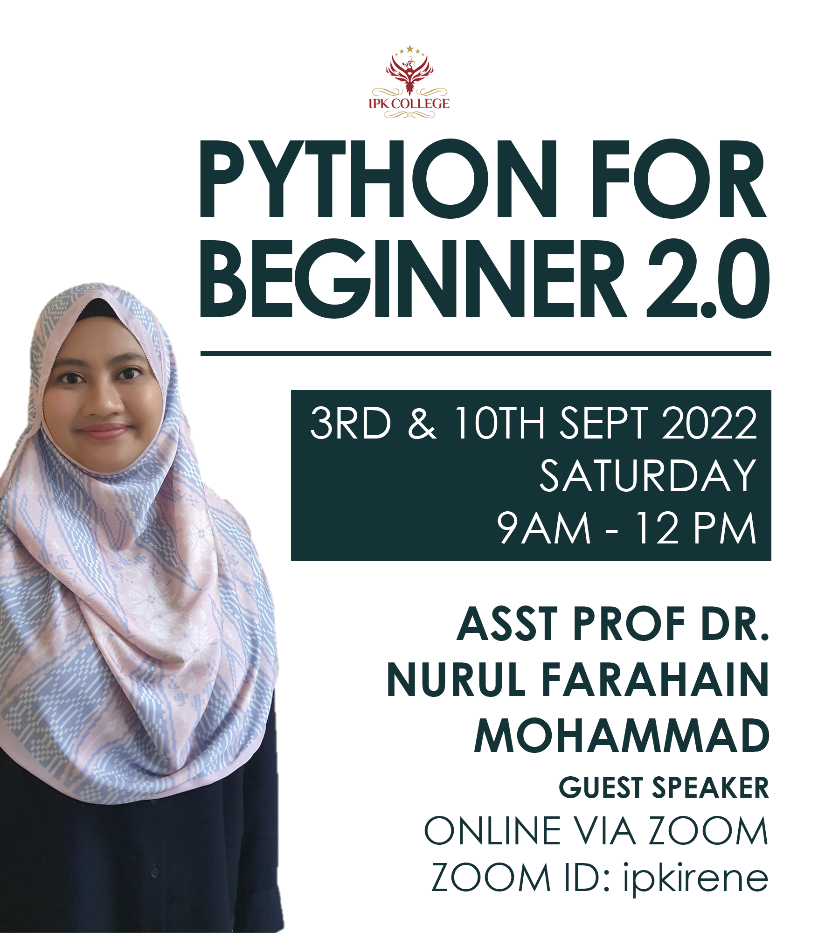
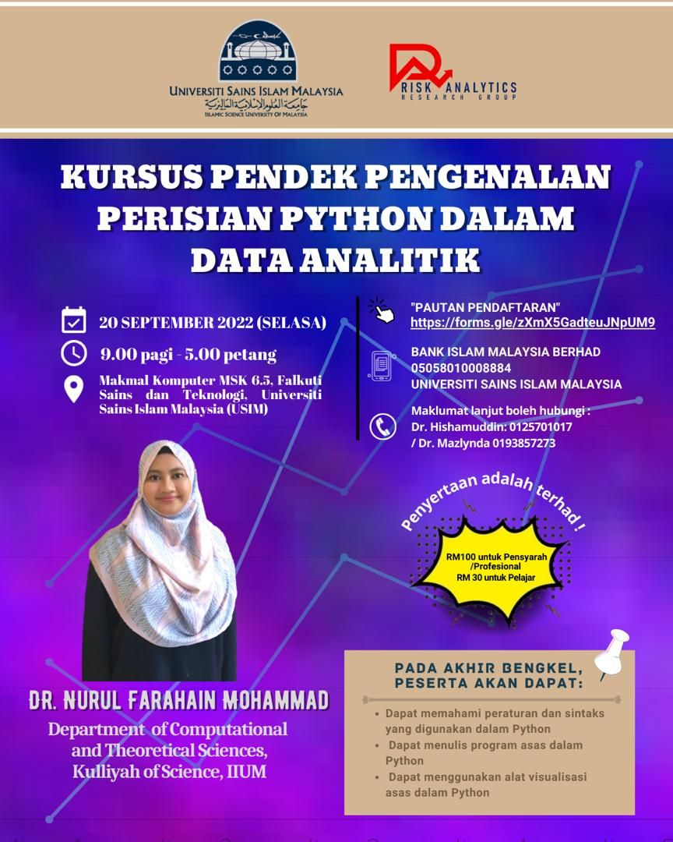
Python Workshops

Slide 5
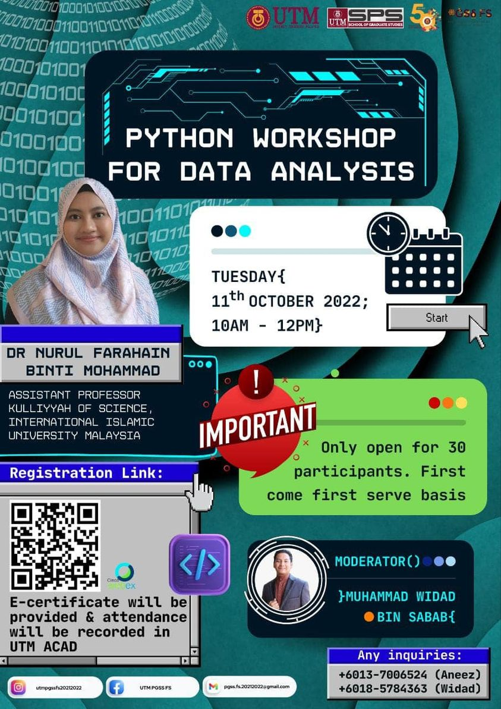
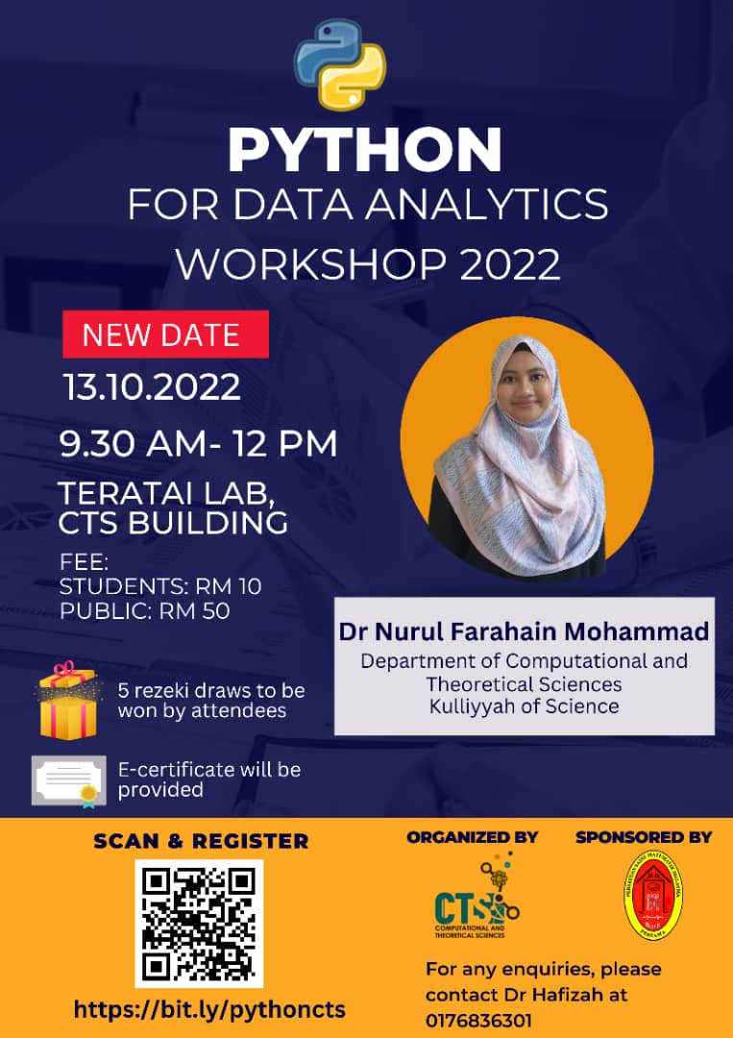
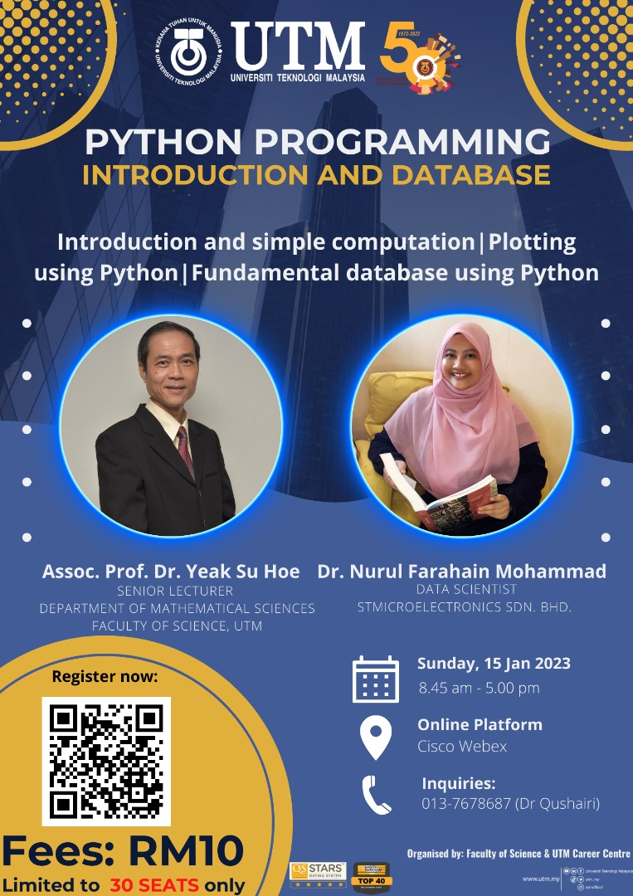
Python Workshops

Slide 6
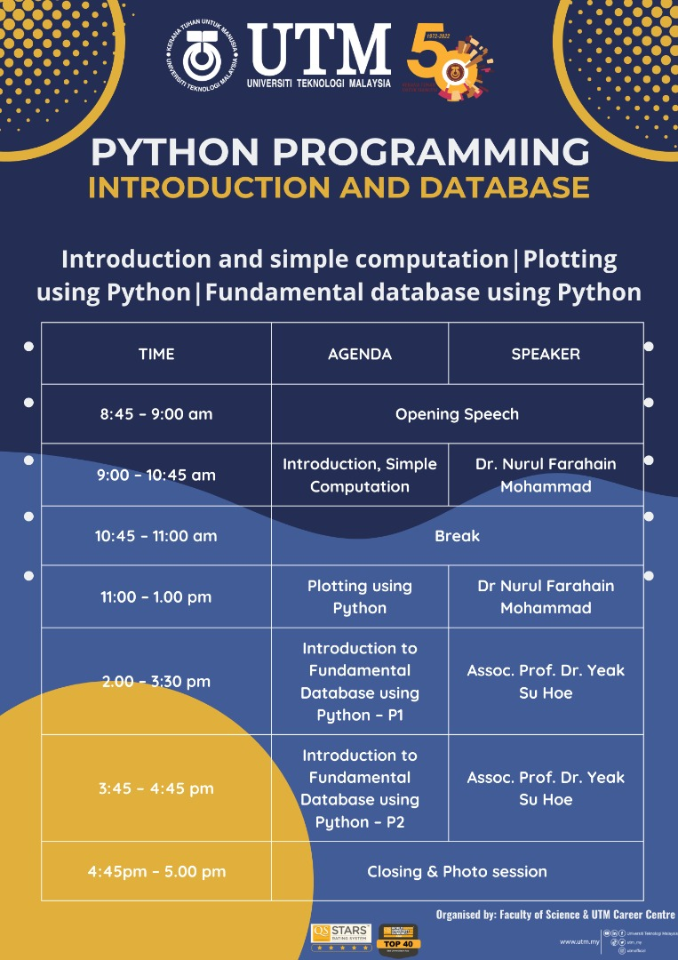

Slide 7
What Will We Learn
Get-to-know Python
Print
Arithmetic operation
Variable
Variable type
Function
Boolean
Control flow
Libraries
Shaw, Z. (2017). Learn Python 3 The Hard Way: A Very Simple Introduction to the Terrifyingly Beautiful World of Computers and Code. Addison-Wesley Professional.

Slide 8



What Will We Learn
Dataframe
Import data
Data wrangling
2D plot
McKinney, W. (2018). Python for Data Analysis: Data Wrangling with Pandas, Numpy and IPython, 2nd edition. O'Reilly Media, Inc.

Slide 9
RESOURCE CENTER
https://padlet.com/f4r4/pythondata
Please download the Jupyter Notebook.

Slide 10

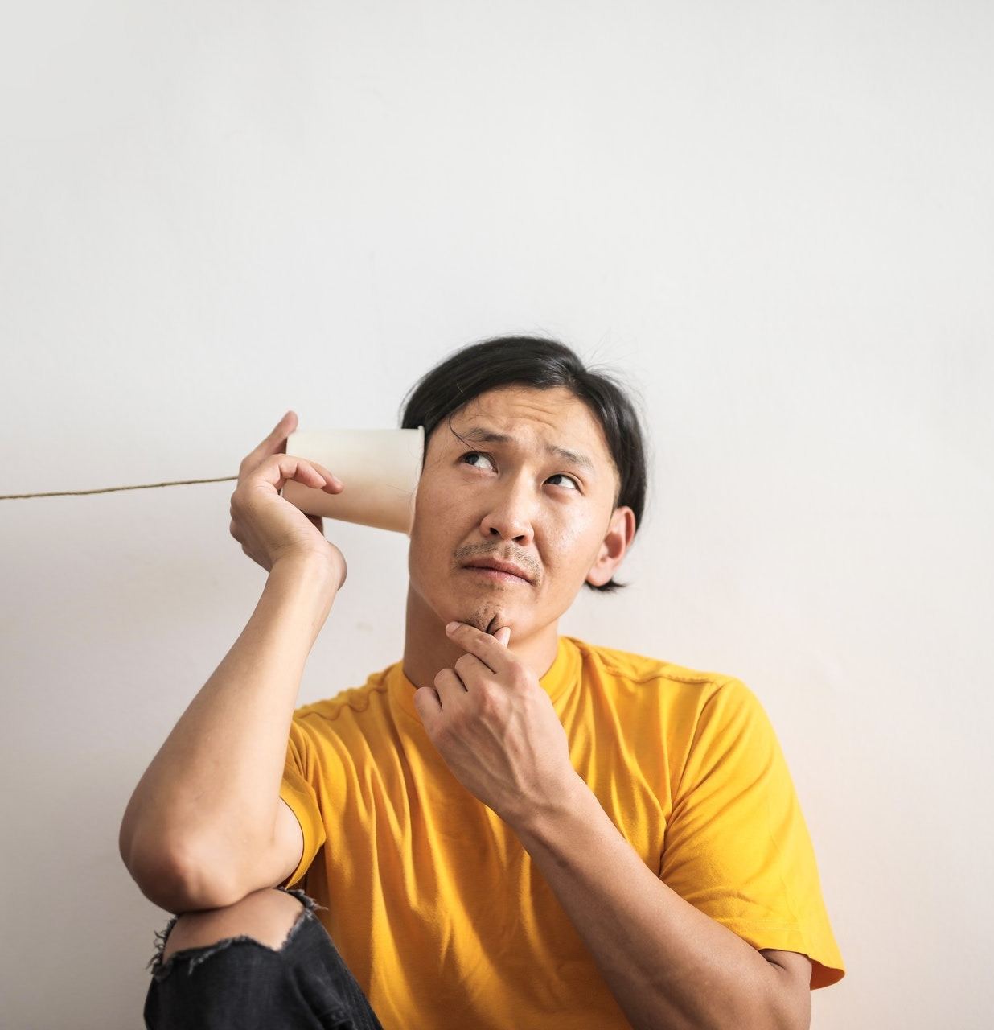
Heard of Python?
Of course. You mean that big gigantic snake right?
Yes. The programming language is 🔥🔥
Nope. This is the first time I heard of it.

Slide 11

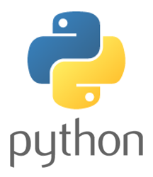

What is Python?
General Purpose Programming Language
1991
First released on 1991
Can be used for nearly everything
Guido van Rossum
.py
.ipynb
The creator
File extensions

Slide 12


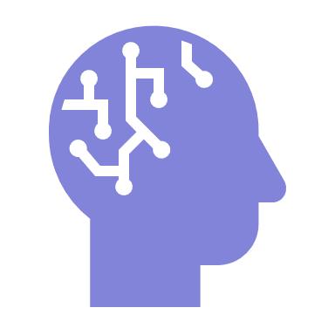
Why Python?
SIMPLE
WIDE APPLICATIONS
IT’S THE FUTURE
Easy to learn
Simple syntax
Readable codes
AI
Data Science
Web & Apps Dev
Scientific Computing
You name it!
School students and AI practitioners all around the world use Python.

Slide 13
Who Use Python?
Among the famous ones.
Instagram
Netflix
Spotify
Google
Bloomberg
Dropbox
Walt Disney Animation Studios
AstraZeneca
Shopee

Slide 14
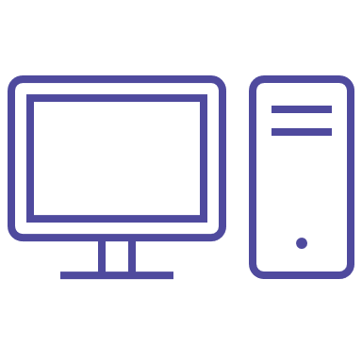

How to Run Python?
INSTALL
NO INSTALL (online)
Basic Python
Anaconda
Jupyter Notebook
PyCharm
Spyder
Visual Studio Code
Google Colaboratory
Binder
CoCalc
Microsoft Azure Notebook

Slide 15
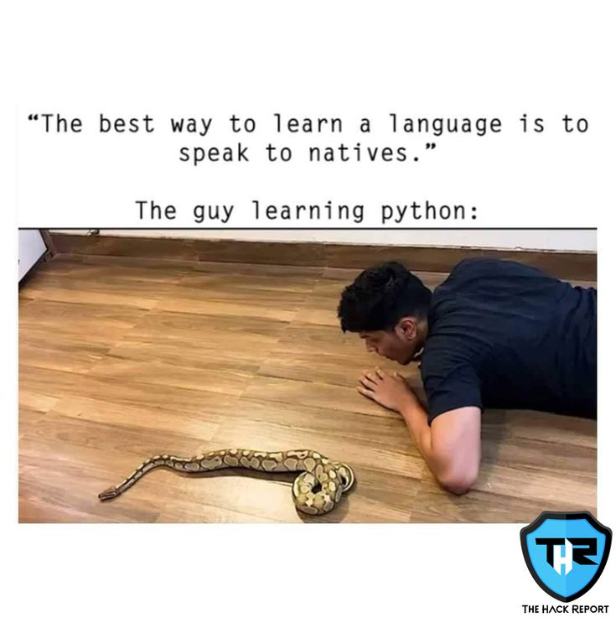
Let’s start.

Slide 16
RESOURCE CENTER
https://padlet.com/f4r4/pythondata
Please download the Jupyter Notebook.

